Slide 1
Build a Small Network and Preparation and Guideline for Assessment 2
Week 11
Dr. Farshid Keivanian

Slide 2
Chapter 11: Build a Small Network
Introduction to Networking
Presentation_ID

Slide 3
Chapter 11: Objectives
Identify the devices and protocols used in a small network
Explain how a small network serves as the basis of larger
networks.
Explain the need for basic security measures on network devices.
Identify security vulnerabilities and general mitigation techniques
Use the output of ping and tracert commands to establish relative network performance.
Use basic show commands to verify the configuration and status of a device interface.
Explain the file systems on Routers and Switches.
Apply the commands to back up and restore an IOS configuration file.
Presentation_ID

Slide 4
Choosing Devices for a Small Network
What should we consider when selecting networking devices?
When building a small network, we need to choose suitable routers, switches and wireless access points.
Five important factors:
Cost: Can the organisation afford the devices and ongoing maintenance?
Ports: Are there enough connections for computers, printers and other devices?
Speed: Can the devices handle the required network traffic?
Scalability: Can the network support more users and devices in the future?
Management: Can IT staff easily configure, monitor and troubleshoot the devices?
3
Presentation_ID
© 2008 Cisco Systems, Inc. All rights reserved.

Slide 5
Choosing Devices for a Small Network
Example in Australia: A small accounting office in Sydney has 15 computers, two printers and a Wi-Fi network. The business needs a suitable router, a switch with enough ports and wireless access.
Discussion question: If a business has 15 computers and expects to grow to 22 computers next year, would you recommend a 16-port or 24-port switch?
Simple answer: A 24-port switch is better because it supports future growth, although additional ports may be needed for printers and access points.
3
Presentation_ID
© 2008 Cisco Systems, Inc. All rights reserved.

Slide 6
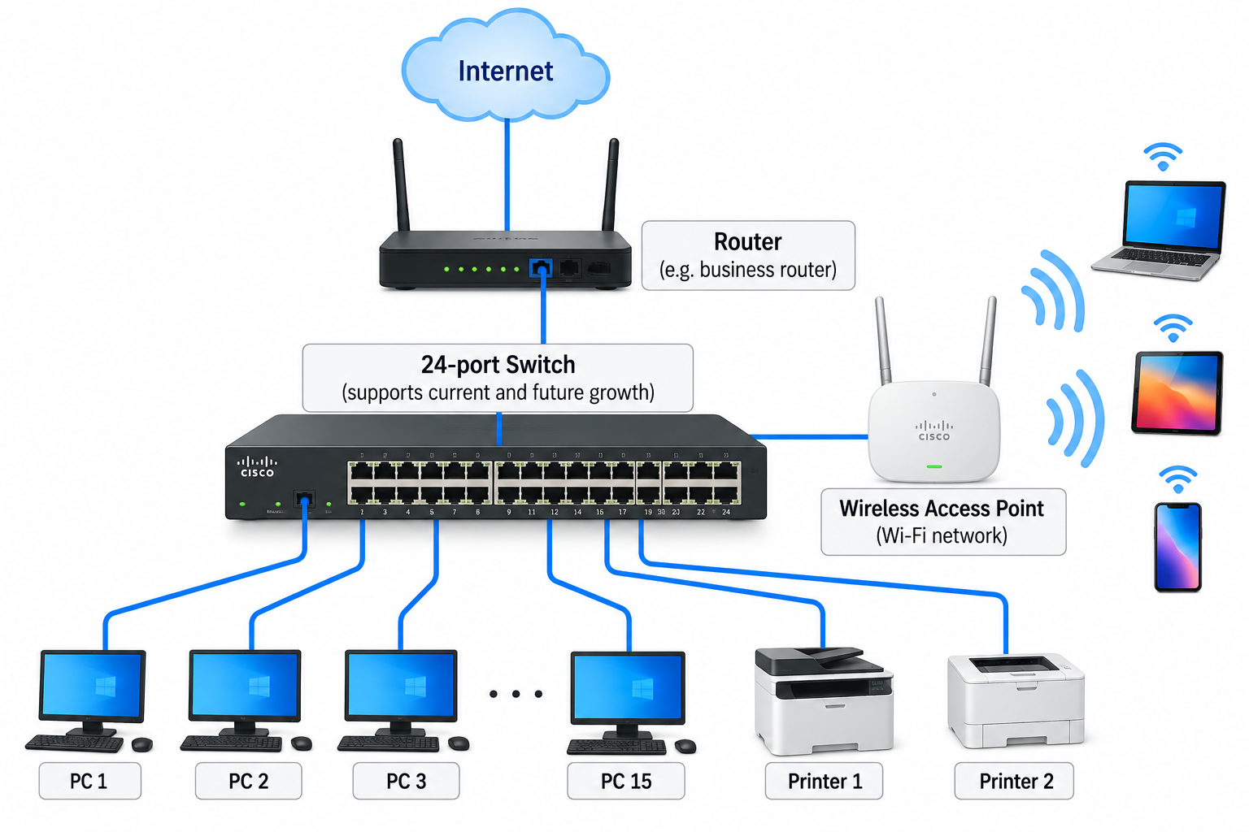
Choosing Devices for a Small Network
3
Presentation_ID
© 2008 Cisco Systems, Inc. All rights reserved.

Slide 7
Planning IP Addresses for a Small Network
Why do we need an IP addressing plan?
Every device communicating over an IP network needs an appropriate IP configuration.
A good IP addressing plan helps us:
Assign addresses without conflicts.
Identify devices more easily.
Troubleshoot connection problems.
Organise different groups of devices.
Plan for future network growth.
3
Presentation_ID
© 2008 Cisco Systems, Inc. All rights reserved.

Slide 8
Planning IP Addresses for a Small Network
Two common approaches:
Static IP: Manually configured address, often used for routers, servers and network printers.
Dynamic IP: Automatically assigned using DHCP, commonly used for laptops and desktop computers.
3
Presentation_ID
© 2008 Cisco Systems, Inc. All rights reserved.

Slide 9
Planning IP Addresses for a Small Network
Example in Australia: A small Sydney training centre uses the network 192.168.10.0/24.
Device | Example IP address | Method
Router | 192.168.10.1 | Static
Network printer | 192.168.10.10 | Static
File server | 192.168.10.20 | Static
Student computers | 192.168.10.100–199 | DHCP
3
Presentation_ID
© 2008 Cisco Systems, Inc. All rights reserved.

Slide 10
Planning IP Addresses for a Small Network
Discussion question: Why might we give a network printer a fixed IP address?
Simple answer: So computers can consistently find the printer at the same address.
3
Presentation_ID
© 2008 Cisco Systems, Inc. All rights reserved.

Slide 11
Common Protocols in a Small Network
What is a network protocol?
A network protocol is a set of rules that allows devices to communicate.
Protocols define how messages are formatted, sent, received and understood.
3
Presentation_ID
© 2008 Cisco Systems, Inc. All rights reserved.

Slide 12
Common Protocols in a Small Network
Protocol | Main purpose
DHCP | Automatically provides IP configuration
DNS | Converts domain names into IP addresses
HTTP/HTTPS | Transfers web content
SMTP/IMAP | Sends and accesses email
SSH | Provides secure remote access
FTP/SFTP | Transfers files
ICMP | Supports network testing and error reporting
3
Presentation_ID
© 2008 Cisco Systems, Inc. All rights reserved.

Slide 13
Common Protocols in a Small Network
Example in Australia: When a student connects to campus Wi-Fi and opens the university website, DHCP may provide the network settings, DNS finds the website's IP address, and HTTPS transfers the web content securely.
Discussion question: Which protocol helps a computer find the IP address of a website such as www.abc.net.au?
Simple answer: DNS.
3
Presentation_ID
© 2008 Cisco Systems, Inc. All rights reserved.

Slide 14
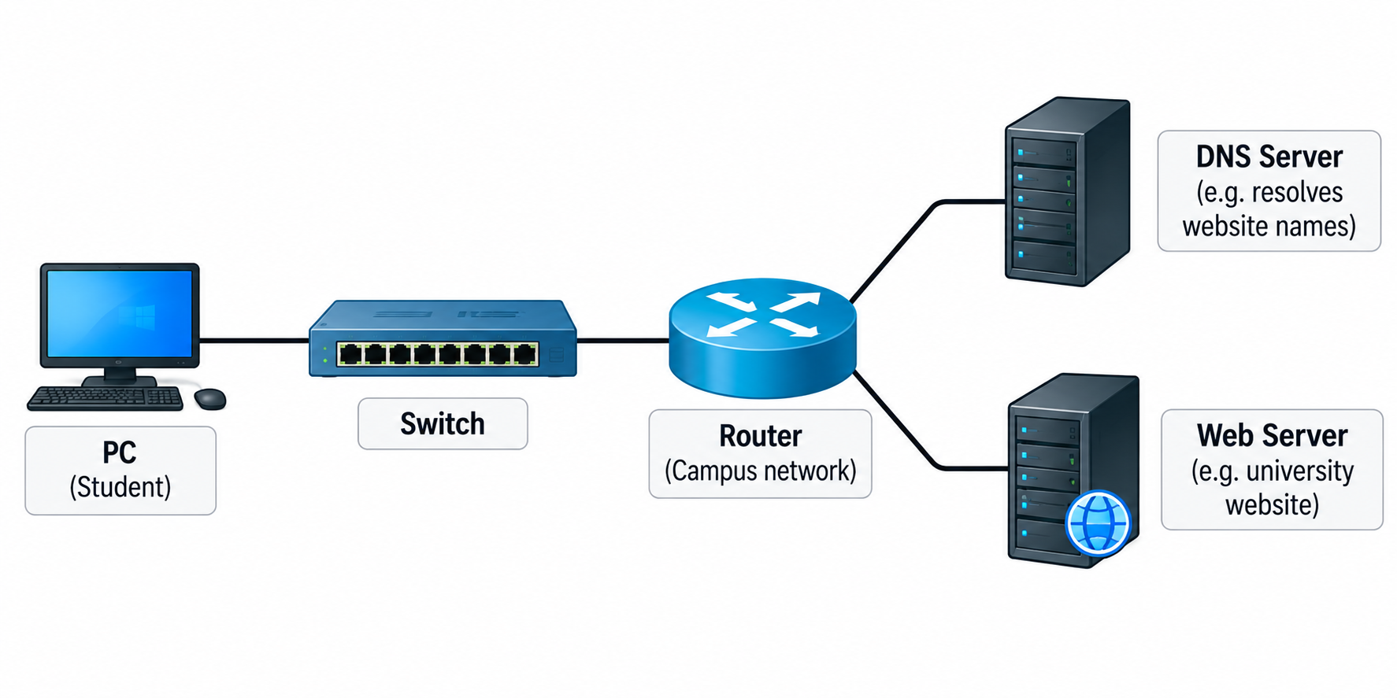
Common Protocols in a Small Network
3
Presentation_ID
© 2008 Cisco Systems, Inc. All rights reserved.

Slide 15
Common Security Threats to Small Networks
What can go wrong if a network is not secure?
Small networks face several security risks.
Information theft: Someone accesses confidential files without permission.
Data loss or modification: Important files are deleted, damaged or changed.
Identity theft: Someone steals personal information and uses it fraudulently.
Service disruption: Users cannot access websites, servers or network services.
3
Presentation_ID
© 2008 Cisco Systems, Inc. All rights reserved.

Slide 16
Common Security Threats to Small Networks
Example in Australia: A small Australian business may experience a ransomware attack that encrypts its files and prevents employees from accessing customer records.
Discussion question: If a company's network becomes unavailable because of an attack, which type of security threat has occurred?
Simple answer: Service disruption. The attack may also cause data loss or other damage.
3
Presentation_ID
© 2008 Cisco Systems, Inc. All rights reserved.

Slide 17
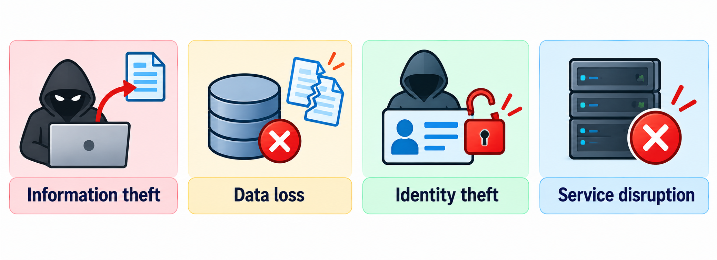
Common Security Threats to Small Networks
3
Presentation_ID
© 2008 Cisco Systems, Inc. All rights reserved.

Slide 18
Understanding Malware: Viruses, Worms and Trojans
Malware is software designed to damage systems, steal information or perform unwanted actions.
Three common types:
Type | Simple explanation
Virus | Malicious code that attaches to a file or program and spreads when it runs
Worm | Malware that can spread automatically between vulnerable devices
Trojan | Malicious software disguised as a useful or legitimate application
3
Presentation_ID
© 2008 Cisco Systems, Inc. All rights reserved.

Slide 19
Understanding Malware: Viruses, Worms and Trojans
Example in Australia: An employee receives an email claiming to contain an important invoice. The attachment appears legitimate but installs a Trojan when opened.
Discussion question: What is the main difference between a worm and a Trojan?
Simple answer: A worm can spread automatically, while a Trojan tricks someone into installing or running malicious software.
3
Presentation_ID
© 2008 Cisco Systems, Inc. All rights reserved.

Slide 20
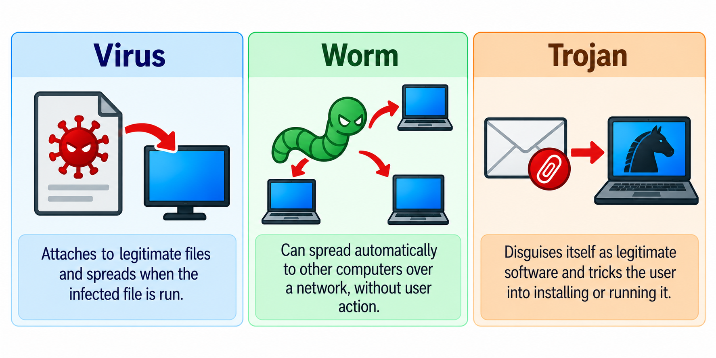
Understanding Malware: Viruses, Worms and Trojans
3
Presentation_ID
© 2008 Cisco Systems, Inc. All rights reserved.

Slide 21
Reconnaissance: How Attackers Gather Network Information
What is reconnaissance in network security?
Reconnaissance means collecting information about a network or its devices.
Common techniques include:
Internet searches: Finding publicly available information about an organisation.
Ping checks: Testing whether a device responds to network messages.
Port scanning: Identifying accessible network services.
Packet capture: Examining network traffic when the person has access to capture it.
3
Presentation_ID
© 2008 Cisco Systems, Inc. All rights reserved.

Slide 22
Reconnaissance: How Attackers Gather Network Information
These techniques are also used legitimately by authorised network administrators for troubleshooting and security testing.
Example in Australia: An authorised IT administrator at a Sydney college checks which devices are responding and whether unnecessary network services are exposed.
Discussion question: Why should organisations disable network services they do not need?
Simple answer: Because unnecessary services may create additional opportunities for attackers to access or exploit devices.
3
Presentation_ID
© 2008 Cisco Systems, Inc. All rights reserved.

Slide 23
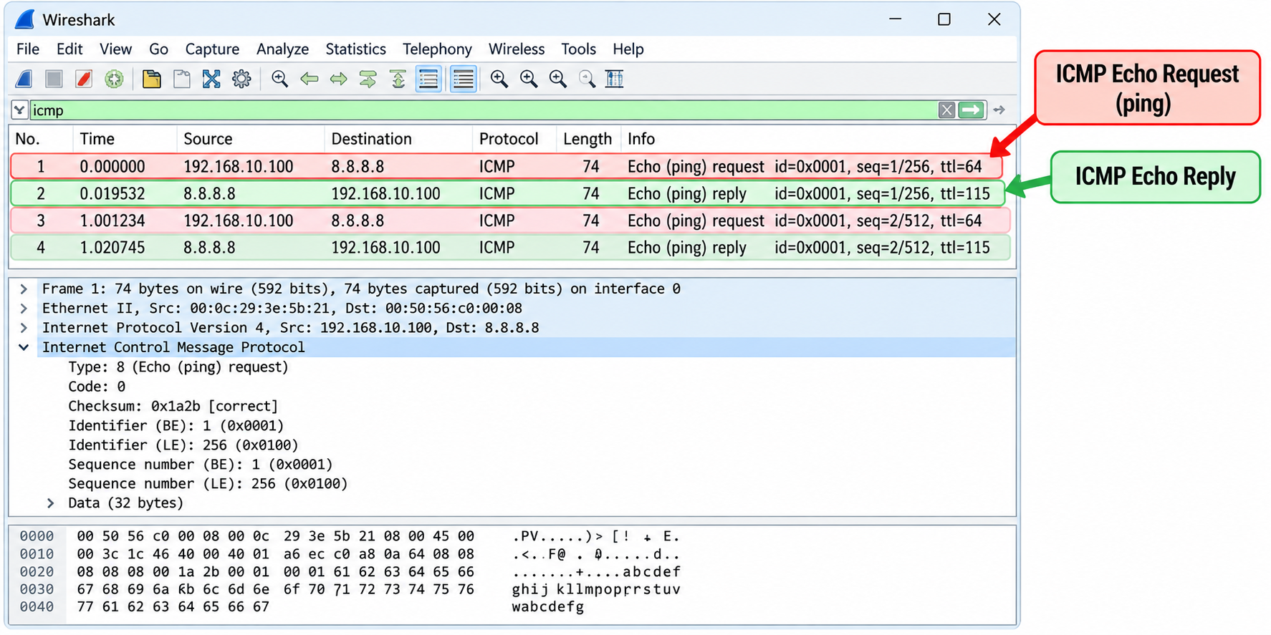
Reconnaissance: How Attackers Gather Network Information
3
Presentation_ID
© 2008 Cisco Systems, Inc. All rights reserved.

Slide 24
Protecting a Small Network: Backup, Update and Patch
How can we reduce network security risks?
Five practical security measures:
Back up important data: Keep recoverable copies of files in case they are lost or damaged.
Update software: Install supported versions of operating systems and applications.
Apply security patches: Fix known software vulnerabilities.
Use endpoint protection: Detect and block many types of malicious software.
Control access: Use strong passwords, multi-factor authentication where supported, and appropriate user permissions.
3
Presentation_ID
© 2008 Cisco Systems, Inc. All rights reserved.

Slide 25
Protecting a Small Network: Backup, Update and Patch
Example in Australia: A small medical clinic in Sydney regularly backs up its records, installs security updates and limits access to patient information to authorised staff.
Discussion question: Why are backups important even when antivirus software is installed?
Simple answer: Antivirus software cannot prevent every incident. Backups help recover important files after ransomware, accidental deletion or equipment failure.
3
Presentation_ID
© 2008 Cisco Systems, Inc. All rights reserved.

Slide 26
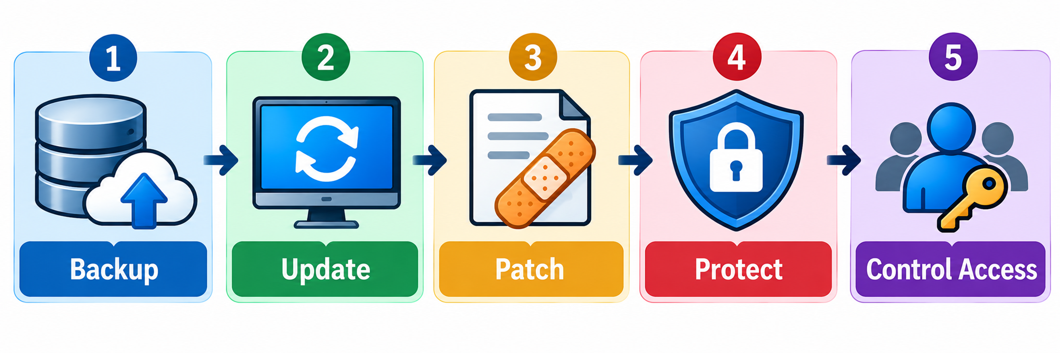
Protecting a Small Network: Backup, Update and Patch
3
Presentation_ID
© 2008 Cisco Systems, Inc. All rights reserved.

Slide 27
AAA: Controlling Access to a Network
What is AAA?
AAA stands for Authentication, Authorization and Accounting. It helps organisations control and monitor network access.
Authentication – Who are you? Verifies a user's identity using a password, passkey or multi-factor authentication.
Authorization – What can you do? Determines which files, systems or network functions a user can access.
Accounting – What did you do? Records user activities, such as login times and configuration changes.
3
Presentation_ID
© 2008 Cisco Systems, Inc. All rights reserved.

Slide 28
AAA: Controlling Access to a Network
Example in Australia: At an Australian university, students sign in using their university accounts (authentication), access their enrolled units (authorization), and certain system activities are recorded for security purposes (accounting).
Discussion question: If a student logs into a university system successfully but cannot change another student's grades, which AAA function prevents this?
Simple answer: Authorization, because it controls what the student is allowed to do.
3
Presentation_ID
© 2008 Cisco Systems, Inc. All rights reserved.

Slide 29
AAA: Controlling Access to a Network
3
Presentation_ID
© 2008 Cisco Systems, Inc. All rights reserved.

Slide 30
Securing Cisco Routers and Switches
How can we protect network devices from unauthorised access?
Cisco routers and switches should use basic security settings.
Strong passwords: Protect administrator accounts using long, unique passwords.
Password protection: Use enable secret for privileged access; avoid storing passwords in plain text.
Login protection: Limit repeated unsuccessful login attempts.
Session timeout: Automatically close inactive administrator sessions.
Security banner: Display an authorised-use warning.
SSH: Allow encrypted remote management instead of insecure Telnet.
3
Presentation_ID
© 2008 Cisco Systems, Inc. All rights reserved.

Slide 31
Securing Cisco Routers and Switches
Example in Australia: An IT administrator at a Sydney college configures secure passwords and SSH so authorised staff can manage the college's routers without exposing their login credentials over the network.
Discussion question: Why is SSH safer than Telnet for managing a router?
Simple answer: SSH encrypts the connection, while Telnet sends information without encryption.
3
Presentation_ID
© 2008 Cisco Systems, Inc. All rights reserved.

Slide 32
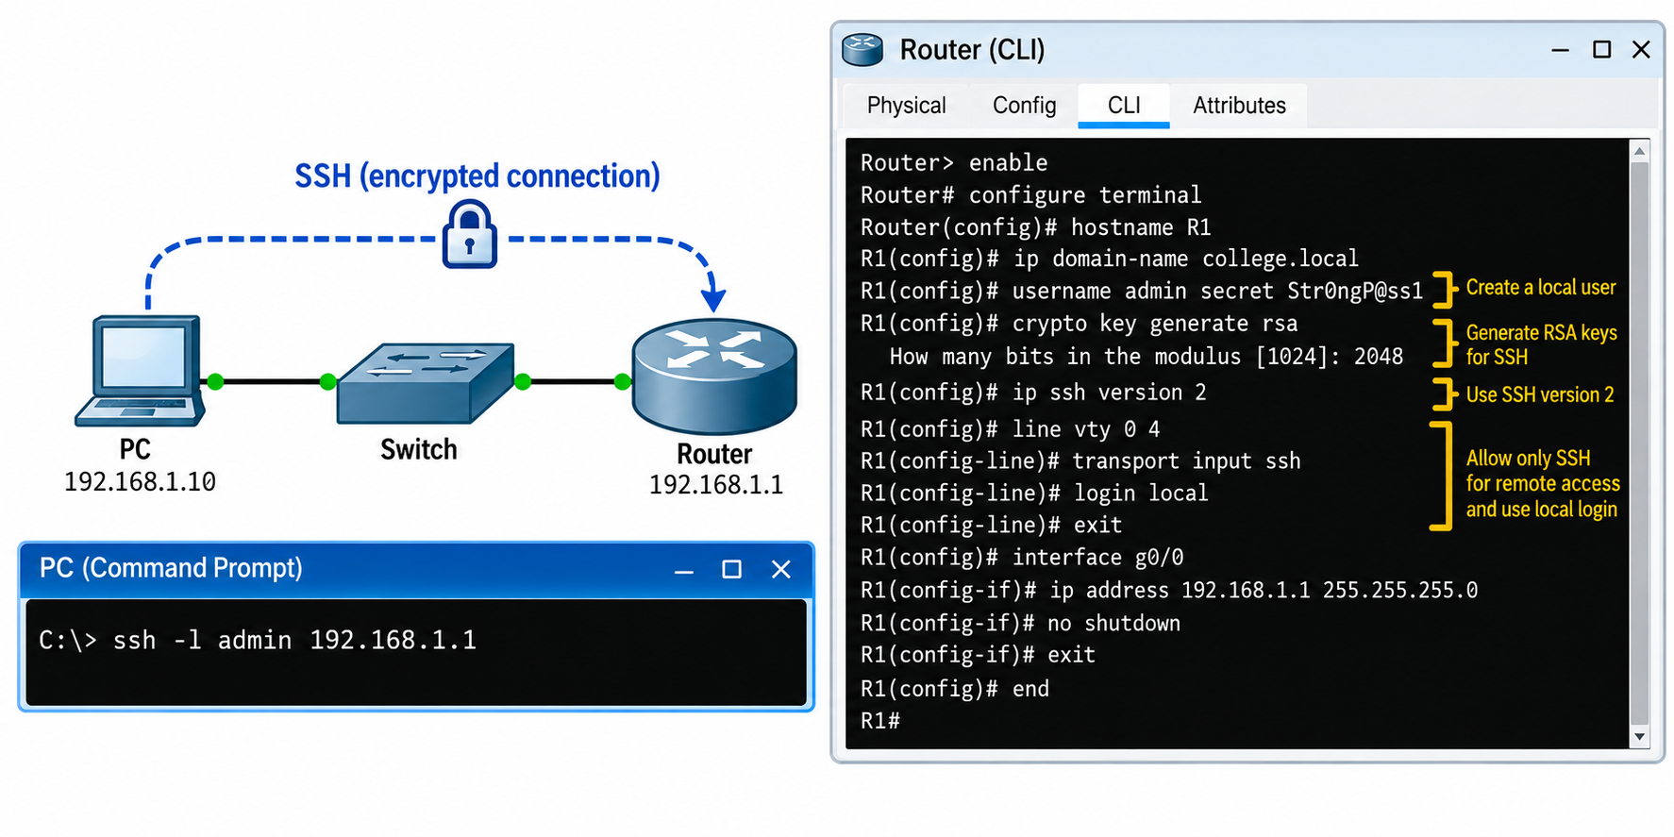
Securing Cisco Routers and Switches
3
Presentation_ID
© 2008 Cisco Systems, Inc. All rights reserved.

Slide 33
Example Cisco IOS configuration
enable
configure terminal
hostname R1
enable secret ClassDemo2026!
service password-encryption
security passwords min-length 10
login block-for 120 attempts 3 within 60
banner motd #Authorised access only#
username admin privilege 15 secret SecureAdmin2026!
ip domain-name lab.example
crypto key generate rsa modulus 2048
ip ssh version 2
line vty 0 4
login local
transport input ssh
exec-timeout 5 0
end
copy running-config startup-config
service password-encryption provides only weak protection for certain stored passwords; it is not a substitute for secret credentials. Modern production networks should use stronger authentication and centrally managed access where appropriate.
3
Presentation_ID
© 2008 Cisco Systems, Inc. All rights reserved.

Slide 34
Useful Cisco Show Commands
How can we check what is happening on a router or switch?
Cisco IOS provides show commands to display network information without changing device settings.
Command | What it shows
show running-config | Current device configuration
show ip interface brief | IP addresses and interface status
show interfaces | Detailed interface information and errors
show ip route | Routes known to the router
show arp | IP-to-MAC address mappings
show version | Cisco IOS and device information
show protocols | Protocol and interface status
3
Presentation_ID
© 2008 Cisco Systems, Inc. All rights reserved.

Slide 35
Useful Cisco Show Commands
Example in Australia: A Sydney office cannot connect to another branch. The IT technician uses show ip interface brief to check whether the router interfaces are working.
Discussion question: Which command would you use first to quickly check whether a router interface is up or down?
Simple answer: show ip interface brief.
3
Presentation_ID
© 2008 Cisco Systems, Inc. All rights reserved.

Slide 36
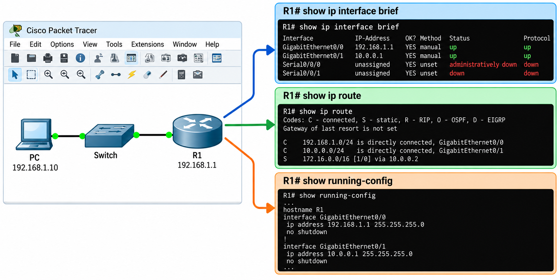
Useful Cisco Show Commands
3
Presentation_ID
© 2008 Cisco Systems, Inc. All rights reserved.

Slide 37
Checking Router Information with Show Version
What can we learn about a Cisco router?
The command show version provides useful information about the router's hardware and software.
It can display:
Cisco IOS version: The operating system version running on the router.
System image: The software image used to start the router.
Hardware information: Router model, processor and memory.
Interfaces: Information about the router's network interfaces.
Configuration register: A setting that influences how the router starts.
3
Presentation_ID
© 2008 Cisco Systems, Inc. All rights reserved.

Slide 38
Checking Router Information with Show Version
Example in Australia: An IT technician at a Melbourne business uses show version to identify the router model and IOS version before planning a software upgrade.
Discussion question: Why should an administrator check the IOS version before updating a router?
Simple answer: To identify the current software and check which updates are compatible with the device.
3
Presentation_ID
© 2008 Cisco Systems, Inc. All rights reserved.

Slide 39
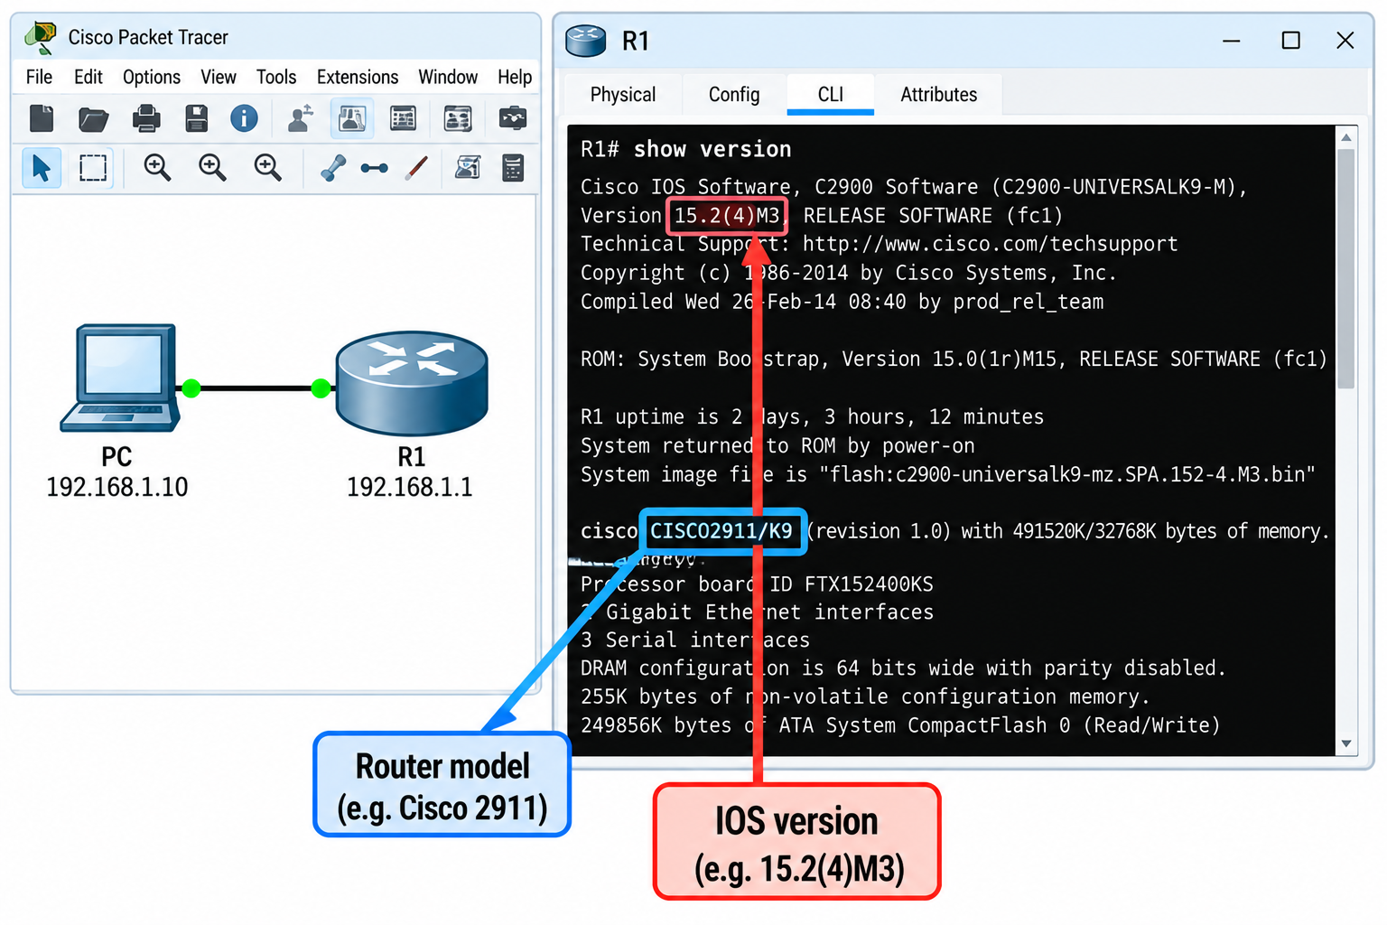
Checking Router Information with Show Version
3
Presentation_ID
© 2008 Cisco Systems, Inc. All rights reserved.

Slide 40
Checking Computer Network Settings with ipconfig
How can we check the network settings of a Windows computer?
Windows provides the ipconfig command to view IP configuration information.
3
Presentation_ID
© 2008 Cisco Systems, Inc. All rights reserved.

Slide 41
Checking Computer Network Settings with ipconfig
Command | Purpose
ipconfig | Displays IP address, subnet mask and default gateway
ipconfig /all | Displays detailed information, including MAC address, DHCP and DNS settings
ipconfig /displaydns | Displays cached DNS records
ipconfig /release | Releases a DHCP-assigned IPv4 address
ipconfig /renew | Requests a DHCP address
3
Presentation_ID
© 2008 Cisco Systems, Inc. All rights reserved.

Slide 42
Checking Computer Network Settings with ipconfig
Example in Australia: A student connects a laptop to Wi-Fi at a Sydney university but cannot access the internet. The IT support team uses ipconfig /all to check the assigned IP address, default gateway and DNS server.
Discussion question: If a Windows computer has an IPv4 address beginning with 169.254, what might this indicate?
Simple answer: The computer may not have received an IPv4 address from DHCP and has assigned itself a link-local address.
3
Presentation_ID
© 2008 Cisco Systems, Inc. All rights reserved.

Slide 43
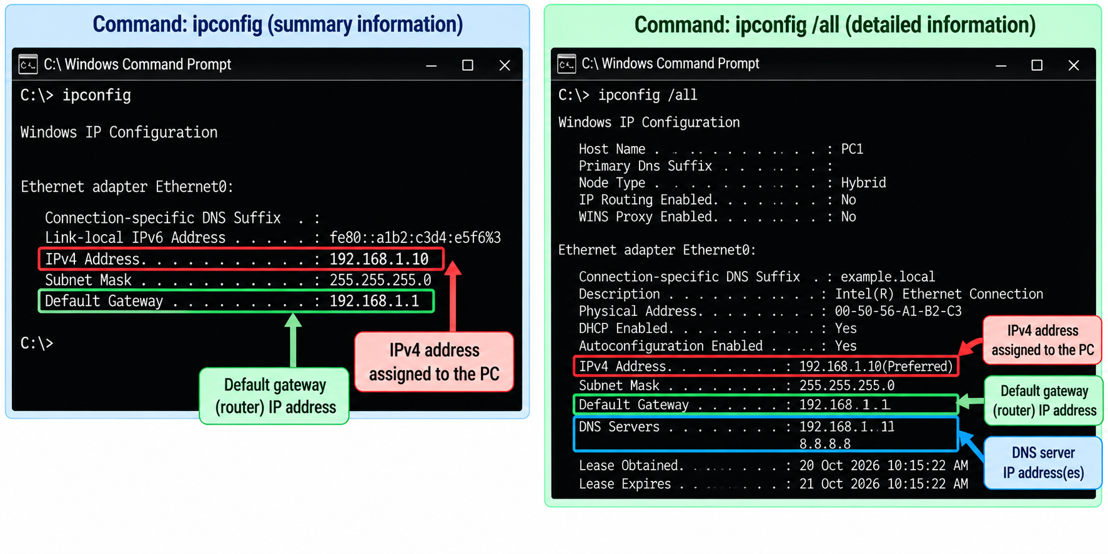
Checking Computer Network Settings with ipconfig
3
Presentation_ID
© 2008 Cisco Systems, Inc. All rights reserved.

Slide 44
Discovering Connected Devices with CDP
How can a router identify its directly connected Cisco neighbours?
Cisco Discovery Protocol (CDP) helps Cisco devices discover information about nearby Cisco networking devices.
Two useful commands:
show cdp neighbors — displays directly connected Cisco devices and their interfaces.
show cdp neighbors detail — provides additional information, which may include device IP addresses and software details.
CDP can help administrators identify connections and troubleshoot cabling or topology problems.
3
Presentation_ID
© 2008 Cisco Systems, Inc. All rights reserved.

Slide 45
Discovering Connected Devices with CDP
Example in Australia: A network administrator at a Brisbane office wants to identify which Cisco switch is connected to a particular router interface. The administrator uses show cdp neighbors.
Discussion question: If a router is connected to two Cisco switches, which command can help identify those switches?
Simple answer: show cdp neighbors, provided CDP is enabled on the relevant devices and interfaces.
3
Presentation_ID
© 2008 Cisco Systems, Inc. All rights reserved.

Slide 46
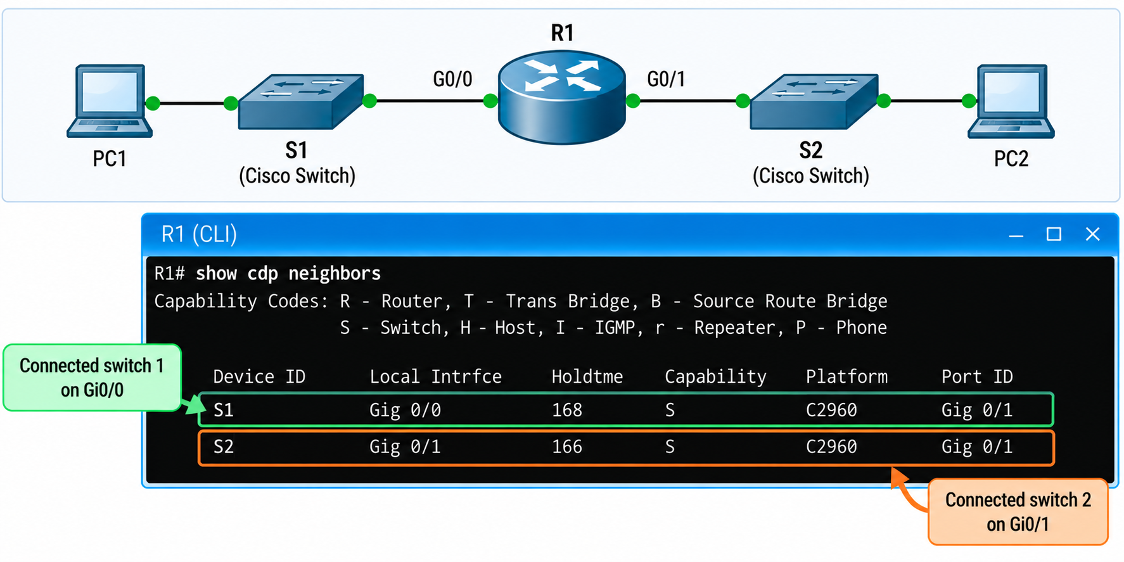
Discovering Connected Devices with CDP
3
Presentation_ID
© 2008 Cisco Systems, Inc. All rights reserved.

Slide 47
Troubleshooting Network Interfaces and Connectivity
How can we find and fix network connection problems?
Three useful Cisco commands:
show ip interface brief — checks interface IP addresses and whether interfaces are up or down.
ping — tests whether a destination responds to ICMP echo requests.
traceroute — helps identify the network path towards a destination.
3
Presentation_ID
© 2008 Cisco Systems, Inc. All rights reserved.

Slide 48
Troubleshooting Network Interfaces and Connectivity
Common interface states:
Interface status | Meaning
up / up | Interface and line protocol are operational
down / down | Interface or connection is not operational
administratively down / down | Interface has been disabled by configuration
up / down | Physical interface is active, but the line protocol is not operational
3
Presentation_ID
© 2008 Cisco Systems, Inc. All rights reserved.

Slide 49
Troubleshooting Network Interfaces and Connectivity
Example in Australia: A small business in Parramatta cannot access its Melbourne branch network. The technician checks the router interfaces, tests connectivity with ping, and uses traceroute to investigate where communication may be failing.
Discussion question: If an interface displays administratively down, what command can enable it?
Simple answer: Enter interface configuration mode and use no shutdown.
3
Presentation_ID
© 2008 Cisco Systems, Inc. All rights reserved.

Slide 50
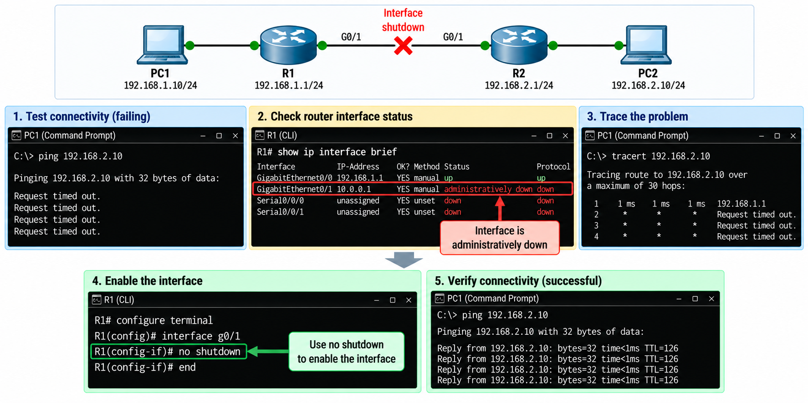
Troubleshooting Network Interfaces and Connectivity
3
Presentation_ID
© 2008 Cisco Systems, Inc. All rights reserved.

Slide 51
Troubleshooting Network Interfaces and Connectivity
Example troubleshooting commands
Router# show ip interface brief
Router# ping 192.168.2.1
Router# traceroute 192.168.2.1
Router# configure terminal
Router(config)# interface gigabitEthernet 0/0
Router(config-if)# no shutdown
3
Presentation_ID
© 2008 Cisco Systems, Inc. All rights reserved.

Slide 52
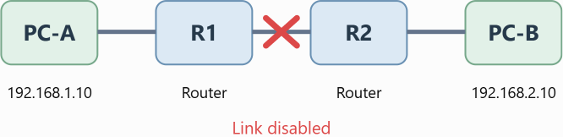
Class activity — Find and Fix the Network Problem
Scenario: PC-A cannot communicate with PC-B because an interface between the routers has been disabled.
Check the router interfaces.
Identify the disabled interface.
Enable it using no shutdown.
Test the connection using ping.
Explain what they changed and why.
3
Presentation_ID
© 2008 Cisco Systems, Inc. All rights reserved.

Slide 53
Class activity — Find and Fix the Network Problem
Expected result: Students restore the connection, assuming all other addressing and routing settings are correct.
3
Presentation_ID
© 2008 Cisco Systems, Inc. All rights reserved.

Slide 54
Knowledge Check: Building and Securing a Small Network
Multiple-Choice Quiz (10 Questions)
Question 1
A small business in Sydney is choosing a new network switch. Which factor is important when selecting the switch?
A. The number of employees using email B. The brand of the office computers C. The colour of the switch D. The number of ports and their speeds
Answer: D. The number of ports and their speeds
3
Presentation_ID
© 2008 Cisco Systems, Inc. All rights reserved.

Slide 55
Knowledge Check: Building and Securing a Small Network
Question 2
A small company in Melbourne wants to organise its computers, printers and servers into different IP address groups. What is the main benefit of planning an IP addressing scheme?
It removes the need for routers
It makes network management and troubleshooting easie
It increases the physical size of the network
It automatically protects the network from all attacks
Answer: B. It makes network management and troubleshooting easier
3
Presentation_ID
© 2008 Cisco Systems, Inc. All rights reserved.

Slide 56
Knowledge Check: Building and Securing a Small Network
Question 3
A university in Brisbane uses DHCP to connect student computers to its network. What is the main purpose of DHCP?
To automatically assign IP addresses and other network settings
To encrypt all network traffic
To transfer files between computers
To identify computer viruses
Answer: A. To automatically assign IP addresses and other network settings
3
Presentation_ID
© 2008 Cisco Systems, Inc. All rights reserved.

Slide 57
Knowledge Check: Building and Securing a Small Network
Question 4
An employee at a Sydney company receives an email containing a malicious attachment. When opened, the attachment installs harmful software that spreads by infecting other files. What type of malware is this?
Firewall
Network switch
Computer virus
DNS server
Answer: C. Computer virus
3
Presentation_ID
© 2008 Cisco Systems, Inc. All rights reserved.

Slide 58
Knowledge Check: Building and Securing a Small Network
Question 5
An attacker attempts to identify active devices and open ports on a company's network before launching an attack. What type of activity is this?
Data backup
Network reconnaissance
Network encryption
Software updating
Answer: B. Network reconnaissance
3
Presentation_ID
© 2008 Cisco Systems, Inc. All rights reserved.

Slide 59
Knowledge Check: Building and Securing a Small Network
Question 6
A Melbourne organisation regularly updates its computers and network devices to protect against known security vulnerabilities. What is the main purpose of installing security patches?
To increase the number of IP addresses
To replace network cables
To change the network topology
To fix known software security weaknesses
Answer: D. To fix known software security weaknesses
3
Presentation_ID
© 2008 Cisco Systems, Inc. All rights reserved.

Slide 60
Knowledge Check: Building and Securing a Small Network
Question 7
A network administrator at a Sydney university logs in to a router using a username and password. The system then checks which commands the administrator is permitted to use. Which AAA function determines the permitted commands?
Authentication
Accounting
Authorization
Addressing
Answer: C. Authorization
3
Presentation_ID
© 2008 Cisco Systems, Inc. All rights reserved.

Slide 61
Knowledge Check: Building and Securing a Small Network
Question 8
A technician at a Brisbane office wants to check the current configuration of a Cisco router. Which command should they use?
show running-config
show version
show ip route
show arp
Answer: A. show running-config
3
Presentation_ID
© 2008 Cisco Systems, Inc. All rights reserved.

Slide 62
Knowledge Check: Building and Securing a Small Network
Question 9
A network administrator wants to identify which Cisco switch is directly connected to a particular router interface. Which command is most appropriate?
show ip route
show cdp neighbors
show version
show running-config
Answer: B. show cdp neighbors
3
Presentation_ID
© 2008 Cisco Systems, Inc. All rights reserved.

Slide 63
Knowledge Check: Building and Securing a Small Network
Question 10
A small business in Parramatta cannot access its Melbourne branch network. The technician checks the router and notices that one interface displays administratively down. Which command can enable the interface?
show interfaces
shutdown
ipconfig /all
no shutdown
Answer: D. no shutdown
3
Presentation_ID
© 2008 Cisco Systems, Inc. All rights reserved.

Slide 64
Assessment 2 – Preparation Guide and Clarifications
Assessment: Practical Task – Subnetting IP Networks
Weighting: 30% (30 marks)
Assessment type: Individual, Lane 2 – Open
Submission: Completed answer script through Canvas
Viva: Short online oral assessment
Due date and viva schedule: Refer to Canvas
3
Presentation_ID
© 2008 Cisco Systems, Inc. All rights reserved.

Slide 65
Assessment 2 – Preparation Guide and Clarifications
1. What do you need to do?
Assessment 2 tests your ability to plan an IPv4 network using Variable Length Subnet Masking (VLSM), explain the benefits of subnetting, and discuss how networking benefits society and the environment.
3
Presentation_ID
© 2008 Cisco Systems, Inc. All rights reserved.

Slide 66
Assessment 2 – Preparation Guide and Clarifications
You must complete three questions:
Question | Task | Marks
Q1 | VLSM calculations and IP address allocation | 20
Q2 | Advantages of subnetting | 6
Q3 | Social and environmental benefits of networking | 4
Total |  | 30
You must submit your own work and be prepared to explain your calculations and written answers during the viva.
3
Presentation_ID
© 2008 Cisco Systems, Inc. All rights reserved.

Slide 67
Assessment 2 – Preparation Guide and Clarifications
2. Question 1 – What exactly is required?
You have been allocated the IPv4 block 135.126.0.0/21.
You must design an addressing scheme for:
Network segment | Required usable hosts
New York LAN | 325
Washington D.C. LAN | 220
Dallas LAN | 50
Router C–A WAN | 2
Router A–B WAN | 2
3
Presentation_ID
© 2008 Cisco Systems, Inc. All rights reserved.

Slide 68
Assessment 2 – Preparation Guide and Clarifications
For each network segment, calculate:
Prefix length, such as /23 or /26.
Subnet mask in dotted-decimal format.
Network address.
First usable host address.
Last usable host address.
Broadcast address.
Complete every column
3
Presentation_ID
© 2008 Cisco Systems, Inc. All rights reserved.

Slide 69
Assessment 2 – Preparation Guide and Clarifications
Important: The addresses must fit within the original /21 block, must not overlap, and must provide enough usable host addresses for each segment.
3. How should you approach VLSM?
Step 1 – Understand the original network.
Identify the network address, prefix length, subnet mask and complete address range of the allocated block.
3
Presentation_ID
© 2008 Cisco Systems, Inc. All rights reserved.

Slide 70
Assessment 2 – Preparation Guide and Clarifications
Step 2 – Arrange networks from largest to smallest.
Begin with the LAN requiring the most host addresses, then continue to the smaller LANs and WAN links.
Step 3 – Select the smallest suitable subnet.
Use the formula:
Usable host addresses = 2^h − 2
Here, h is the number of host bits. This formula applies to the conventional IPv4 subnets used in this assessment.
3
Presentation_ID
© 2008 Cisco Systems, Inc. All rights reserved.

Slide 71
Assessment 2 – Preparation Guide and Clarifications
Step 4 – Calculate the address ranges.
For every subnet, determine the network address, usable host range and broadcast address.
Step 5 – Check subnet boundaries.
The next subnet must begin at a valid network boundary after the previous allocated subnet. Do not simply increase the last octet by one without checking the prefix length.
3
Presentation_ID
© 2008 Cisco Systems, Inc. All rights reserved.

Slide 72
Assessment 2 – Preparation Guide and Clarifications
Step 6 – Verify your design.
Check that every subnet:
Supports the required number of usable hosts.
Uses a valid network address for its prefix.
Has a correct subnet mask and broadcast address.
Does not overlap another subnet.
Remains within the allocated /21 address block.
For this assessment, use /30 for point-to-point WAN links. You do not need to use /31 or /32.
3
Presentation_ID
© 2008 Cisco Systems, Inc. All rights reserved.

Slide 73
Assessment 2 – Preparation Guide and Clarifications
4. Question 2 – What should you explain?
(a) Network administration – 3 marks
Explain how subnetting helps an organisation manage its network.
Consider network organisation, identifying devices, troubleshooting, fault isolation and applying access-control policies.
Australian example: A Sydney university may separate student computers, staff computers and administrative systems into different subnets to simplify management.
3
Presentation_ID
© 2008 Cisco Systems, Inc. All rights reserved.

Slide 74
Assessment 2 – Preparation Guide and Clarifications
(b) Reduced network traffic – 3 marks
Explain how subnetting can reduce unnecessary broadcast traffic and improve network performance.
Remember that routers normally separate IPv4 broadcast domains. Subnetting alone does not automatically improve every aspect of network performance.
Australian example: A Melbourne office may use separate subnets for employee computers and guest devices to limit broadcast traffic within each network.
3
Presentation_ID
© 2008 Cisco Systems, Inc. All rights reserved.

Slide 75
Assessment 2 – Preparation Guide and Clarifications
5. Question 3 – What should you explain?
(a) Online education – 2 marks
Explain how computer networks support online classes, remote learning, communication, collaboration and access to learning resources.
Australian example: Students living in regional NSW can access university learning materials, recorded lectures and online classes without travelling to campus every day.
3
Presentation_ID
© 2008 Cisco Systems, Inc. All rights reserved.

Slide 76
Assessment 2 – Preparation Guide and Clarifications
(b) Resource sharing – 2 marks
Explain how networking allows people to share printers, storage, software and other resources.
Australian example: A university computer laboratory can use shared network printers and central storage instead of purchasing separate equipment for every computer.
Connect your explanation to efficient resource use and the possible reduction of unnecessary hardware, paper and energy consumption.
3
Presentation_ID
© 2008 Cisco Systems, Inc. All rights reserved.

Slide 77
Assessment 2 – Preparation Guide and Clarifications
6. What should you avoid?
Do not allocate a subnet that is too small for its required hosts.
Do not confuse the total number of addresses with usable host addresses.
Do not use the network or broadcast address as a normal host address.
Do not assign overlapping subnet ranges.
Do not allocate addresses outside 135.126.0.0/21.
3
Presentation_ID
© 2008 Cisco Systems, Inc. All rights reserved.

Slide 78
Assessment 2 – Preparation Guide and Clarifications
Do not confuse prefix length, subnet mask and network address.
Do not omit calculations or leave table cells blank.
Do not copy another student's calculations or written responses.
Do not submit AI-generated answers that you have not checked or cannot explain.
Do not provide vague written responses that fail to address the specific question.
Do not miss the scheduled viva or assume that submitting the answer script completes all assessment requirements.
3
Presentation_ID
© 2008 Cisco Systems, Inc. All rights reserved.

Slide 79
Assessment 2 – Preparation Guide and Clarifications
7. How should you prepare for the viva?
The viva is a short individual discussion in which your lecturer may ask you to explain your submitted work.
You should be able to:
Explain what VLSM means and why it is used.
Explain why you selected each subnet mask.
Demonstrate how you calculated usable hosts.
Identify network and broadcast addresses.
3
Presentation_ID
© 2008 Cisco Systems, Inc. All rights reserved.

Slide 80
Assessment 2 – Preparation Guide and Clarifications
Explain how you determined the first and last usable addresses.
Explain why two allocated subnets do not overlap.
Correct a simple subnetting mistake.
Explain your written responses for Questions 2 and 3.
The lecturer may ask you to explain an address or calculation from your own submitted table or solve a similar example.
3
Presentation_ID
© 2008 Cisco Systems, Inc. All rights reserved.

Slide 81
Assessment 2 – Preparation Guide and Clarifications
Preparation tip: Practise explaining each calculation aloud in simple language rather than memorising a table.
8. Academic integrity
This is an individual assessment.
Your calculations, written answers and explanations must demonstrate your own understanding.
3
Presentation_ID
© 2008 Cisco Systems, Inc. All rights reserved.

Slide 82
Assessment 2 – Preparation Guide and Clarifications
During the viva. A correct answer that you cannot explain may raise questions about your understanding or authorship.
9. Submission checklist
Before submitting, confirm that you have completed the following:
3
Presentation_ID
© 2008 Cisco Systems, Inc. All rights reserved.

Slide 83
Assessment 2 – Preparation Guide and Clarifications
I have answered Questions 1, 2 and 3.
I have used the correct original address block: 135.126.0.0/21.
I have allocated the networks from largest to smallest.
I have selected suitable subnet masks for all five segments.
I have completed every required row of the VLSM table.
I have checked all network and broadcast addresses.
I have checked the first and last usable host addresses.
I have verified that no subnets overlap.
I have verified that all subnets remain inside the original /21 block.
3
Presentation_ID
© 2008 Cisco Systems, Inc. All rights reserved.

Slide 84
Assessment 2 – Preparation Guide and Clarifications
I have shown my calculations and working.
I have explained both advantages of subnetting in Question 2.
I have addressed both online education and resource sharing in Question 3.
My submission represents my own work.
I have reviewed the official Canvas rubric.
I have checked the submission deadline and uploaded the correct answer script.
I have confirmed my scheduled viva arrangements.
I can explain my answers without simply reading them.
3
Presentation_ID
© 2008 Cisco Systems, Inc. All rights reserved.

Slide 85
Assessment 2 – Preparation Guide and Clarifications
10. Final advice
The most important part of this assessment is understanding why each subnet has been allocated a particular address range.
Practise the method, check your calculations, and be ready to explain your reasoning.
The viva is an opportunity to demonstrate your understanding of the work you have submitted.
3
Presentation_ID
© 2008 Cisco Systems, Inc. All rights reserved.

Slide 86
Assessment 2 – Preparation Guide and Clarifications
Part B – Student Practice Question Bank
These 20 questions can be shared with students before the viva. They progress from basic IPv4 knowledge to practical VLSM calculations and short explanations.
Recommended use: Students should attempt all questions before checking the answer key. They should also practise explaining how they obtained each answer.
3
Presentation_ID
© 2008 Cisco Systems, Inc. All rights reserved.

Slide 87
Assessment 2 – Preparation Guide and Clarifications
Section 1 – IPv4 and subnetting fundamentals
Questions 1–8
What is the purpose of an IP address in a computer network?
What does the /24 mean in 192.168.10.0/24?
What is the subnet mask for /26?
How many total addresses and usable host addresses are available in a /27 subnet?
3
Presentation_ID
© 2008 Cisco Systems, Inc. All rights reserved.

Slide 88
Assessment 2 – Preparation Guide and Clarifications
What is the difference between a network address and a broadcast address?
What is VLSM, and why is it useful?
Why should the largest LAN normally be allocated first when using VLSM?
Why is /24 insufficient for a LAN requiring 325 usable host addresses?
3
Presentation_ID
© 2008 Cisco Systems, Inc. All rights reserved.

Slide 89
Assessment 2 – Preparation Guide and Clarifications
Section 2 – Practical calculations
Questions 9–15
For 192.168.10.0/26, calculate the first usable address, last usable address and broadcast address.
A LAN requires 60 usable hosts. What is the smallest suitable conventional IPv4 prefix?
A LAN requires 120 usable hosts. Would /26 or /25 be suitable? Explain.
3
Presentation_ID
© 2008 Cisco Systems, Inc. All rights reserved.

Slide 90
Assessment 2 – Preparation Guide and Clarifications
Calculate the network address, first usable address, last usable address and broadcast address for 172.16.4.0/23.
Two WAN routers each require one usable IP address. Which subnet size should you use for their point-to-point link in this assessment?
A student allocates 192.168.1.0/25 and 192.168.1.64/26 to two LANs. Do these subnets overlap?
For the assessment's 135.126.0.0/21 block, identify the subnet mask, complete address range and total number of addresses.
3
Presentation_ID
© 2008 Cisco Systems, Inc. All rights reserved.

Slide 91
Assessment 2 – Preparation Guide and Clarifications
Section 3 – Design and written explanations
Questions 16–20
A Sydney office has three departments requiring 100, 40 and 12 usable host addresses. Select the smallest suitable conventional prefix for each department.
Explain two ways subnetting helps a network administrator.
3
Presentation_ID
© 2008 Cisco Systems, Inc. All rights reserved.

Slide 92
Assessment 2 – Preparation Guide and Clarifications
Explain how subnetting, together with appropriate network configuration, can reduce broadcast traffic.
Give one Australian example of how computer networking supports online education.
Give two examples of shared network resources and explain one possible environmental benefit.
3
Presentation_ID
© 2008 Cisco Systems, Inc. All rights reserved.

Slide 93

Let’s Answer Your Questions
Canvas Inbox – For academic queries.
Email – For formal communication and attachments.
Canvas Discussion – For academic discussions and general queries.
Reminder – Please follow up if you do not receive a response within 3 business days.

Slide 94

Happy Learning and Bright Futures Ahead!
Dr. Farshid Keivanian
Stay Connected:
linkedin.com/in/farshid-keivanian
github.com/FarshidKeivanian
Education is the most powerful weapon you can use to change the world. — Nelson Mandela

